Slide 1


Sooraj Sheregar
15 March 2023

Slide 2
Outline
Executive Summary
Introduction
Methodology
Results
Conclusion
Appendix

Slide 3
Executive Summary
Summary of methodologies:
We are trying to predict the SpaceX Falcon 9 first stage Landing by utilized the data collected from SpaceX API and data collected from Wikipedia with Web scraping. Some basic data wrangling and formatting is done to access the relevant data. Exploratory Data Analysis is performed and Training Labels are determined. Interactive visual analytics are developed using Folium and Plotly Dash. And predictive analysis is performed using classification models.
Summary of all results
Based on the Accuracy score we have come to a conclusion that the models 'Decision tree' is best suited for predicting SpaceX Falcon 9 first stage Landing

Slide 4
Introduction
SpaceX has gained worldwide attention for a series of historic milestones.
It is the only private company ever to return a spacecraft from low-earth orbit, which it first accomplished in December 2010. SpaceX advertises Falcon 9 rocket launches on its website with a cost of 62 million dollars whereas other providers cost upward of 165 million dollars each, much of the savings is because Space X can reuse the first stage.
Therefore if we can determine if the first stage will land, we can determine the cost of a launch.
This information can be used if an alternate company wants to bid against SpaceX for a rocket launch.

Slide 5

Section 1

Slide 6
Methodology
Executive Summary
Data collection methodology:
The required data was collected by Requesting and parsing the SpaceX launch data form SpaceX API using the GET request
We have also collected data from Wikipedia using Web scraping through Beautiful Soup
Perform data wrangling
First the data is filtered for Falcon 9 rockets only and then the missing data in the Payload Mass is replaced with the average payload mass.
The outcomes column is filled with different values of success and failure those data are transformed into binary values 1 for Success and 0 for Failure and placed in a new column 'Class'

Slide 7
Methodology
Executive Summary (continuation)
Perform exploratory data analysis (EDA) using visualization and SQL
Perform interactive visual analytics using Folium and Plotly Dash
Perform predictive analysis using classification models
The data is processed using One Hot Encoder to get the independent variable and the dependent variable, which is split into train and test set.
Find best Hyperparameter for SVM, Classification Trees, K-nearest neighbor and Logistic Regression

Slide 8
Data Collection
The required data was collected by Requesting and parsing the SpaceX launch data form SpaceX API using the GET request
We have also collected data from Wikipedia using Web scraping through Beautiful Soup.
SpaceX API
Send API request using GET request
Receive API response with the DATA
Parse the response & Extract data
Wikipedia (SpaceX Launch Data)
Check for required data
Scrape the website using Beautiful Soup
Send an HTTP request
Receive the HTML response
Parse & Extract the Data

Slide 9
Data Collection – SpaceX API
The API used is SpaceX API
It contains several Data we have filtered it to Falcon 9
The missing value in payload mass is replaced with the Average payload mass
GitHub URL: https://github.com/SoorajSheregar/Capstone-Project/blob/main/Data%20Collection%20API.ipynb
Response
SpaceX API
GET request

Slide 10
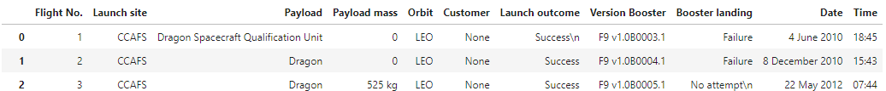
Data Collection - Scraping
Request the Falcon9 Launch Wiki page from its URL: Wikipedia
Extract all column/variable names from the HTML table header
Create a data frame by parsing the launch HTML tables
GitHub URL: https://github.com/SoorajSheregar/Capstone-Project/blob/main/Data%20Collection%20with%20Web%20Scraping.ipynb

Slide 11
Data Wrangling
Payload mass missing values replaced with Average
Exploratory data analysis to find patterns in data
Calculate the number of launches on each site
Calculate the number and occurrence of each orbit
Calculate the number and occurence of mission outcome per orbit type
Create a landing outcome label from Outcome column for success and failure
GitHub URL: https://github.com/SoorajSheregar/Capstone-Project/blob/main/EDA.ipynb

Slide 12
EDA with Data Visualization
Scatterplot of FlightNumber vs. PayloadMass
Increase in FlightNumber : Increase in Success rate of landing
Increase in PayloadMass : Decrease in Success rate of landing
Scatterplot of FlightNumber vs LaunchSite
CCAFS LC-40, has a success rate of 60 %, while KSC LC-39A and VAFB SLC 4E has a success rate of 77%.
But CCAFS LC-40 also has higher number of launches compared to other two.
Scatterplot of Payload vs Launch Site
VAFB SLC 4E used for launching with payload upto 10000Kg
CCAFS LC-40 & KSC LC-39A can be used for higher payload

Slide 13
EDA with Data Visualization
Bar Chart Orbit type vs Success rate
SO has the lowest success rate
ES-L1, GEO, HEO, SSO has the highest Success rate
Scatterplot of FlightNumber vs Orbit
SSO &LEO have better success rate
Scatterplot of Payload vs Orbit
SSO payload mass is below 5000 Kg
VLEO payload mass is above13000 Kg
Line Chart Year vs Success rate
With the increase in year the success rate is also increasing
GitHub URL: https://github.com/SoorajSheregar/Capstone-Project/blob/main/jupyter-labs-eda-dataviz.ipynb.jupyterlite.ipynb

Slide 14
EDA with SQL
SQL queries performed
Display the names of the unique launch sites in the space mission
Display 5 records where launch sites begin with the string 'CCA'
Display the total payload mass carried by boosters launched by NASA (CRS)
Display average payload mass carried by booster version F9 v1.1
List the date when the first succesful landing outcome in ground pad was acheived.
List the names of the boosters which have success in drone ship and have payload mass greater than 4000 but less than 6000
List the total number of successful and failure mission outcomes
List the names of the booster_versions which have carried the maximum payload mass. Use a subquery
List the records which will display the month names, failure landing_outcomes in drone ship ,booster versions, launch_site for the months in year 2015.
Rank the count of successful landing_outcomes between the date 04-06-2010 and 20-03-2017 in descending order.
GitHub URL: https://github.com/SoorajSheregar/Capstone-Project/blob/main/EDA%20with%20SQL-coursera_sqllite.ipynb

Slide 15
Build an Interactive Map with Folium
Using Folium we have created markers, circles on the launch sites.
We have created marker object of colour green for success and colour red for failure.
We have created marker clusters for the launches so that its easily accesible.
We have created lines to display distance from the launch site to nearest city, coast line, Highway, Railway and their distance. etc. you created and added to a folium map.
GitHub URL: https://github.com/SoorajSheregar/Capstone-Project/blob/main/lab_jupyter_launch_site_location.jupyterlite.ipynb

Slide 16
Build a Dashboard with Plotly Dash
We have added Dropdown lists, Pie chart, slider, scatter plot, to the dashboard.
Dropdown list is to enable Launch Site selection.
Pie chart shows the total successful launches count for all sites & if a specific launch site was selected it shows the Success vs. Failed counts for the site.
Slider is to select payload range.
Scatter chart shows the correlation between payload and launch success
GitHub URL: https://github.com/SoorajSheregar/Capstone-Project/blob/main/dashwithpython.py

Slide 17
Predictive Analysis (Classification)
We have built 4 models they are Logistic regression, Support vector machine, Decision tree, K-nearest neighbors.
GridSearchCV is used to evaluate the best hyperparameter suited for the model.
Using the accuracy score and confussion matrix the best performing classification model is found to be Decision tree
Model development process included
GitHub URL: https://github.com/SoorajSheregar/Capstone-Project/blob/main/SpaceX_Machine_Learning_Prediction_Part_5.jupyterlite%20(1).ipynb
Collect data
Standardize data
Train test Split
Train the data on the algorithm
Predict for test data
Evaluate the accuracy

Slide 18
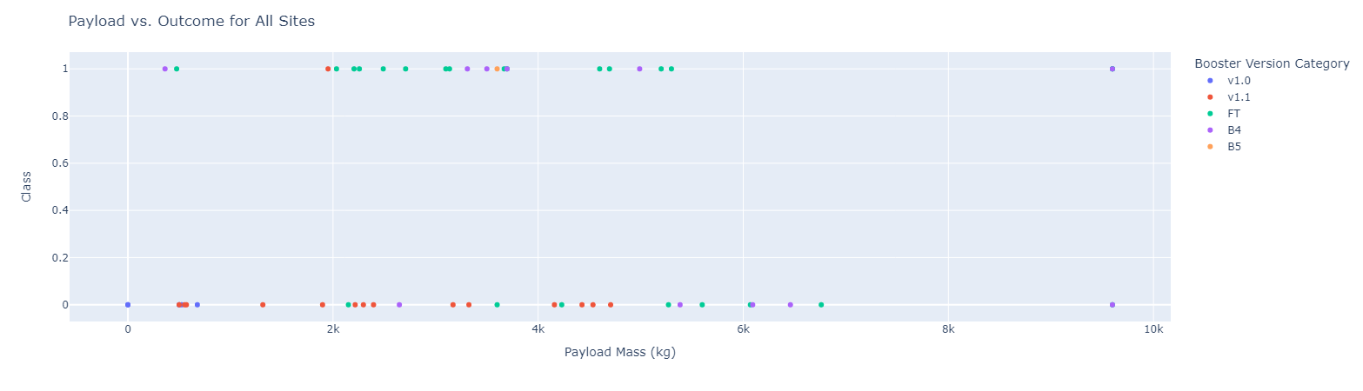
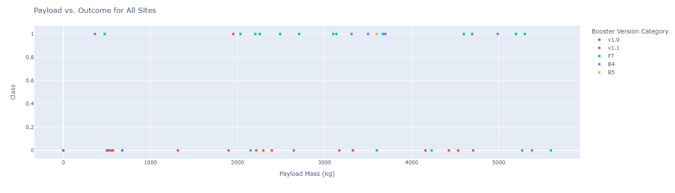
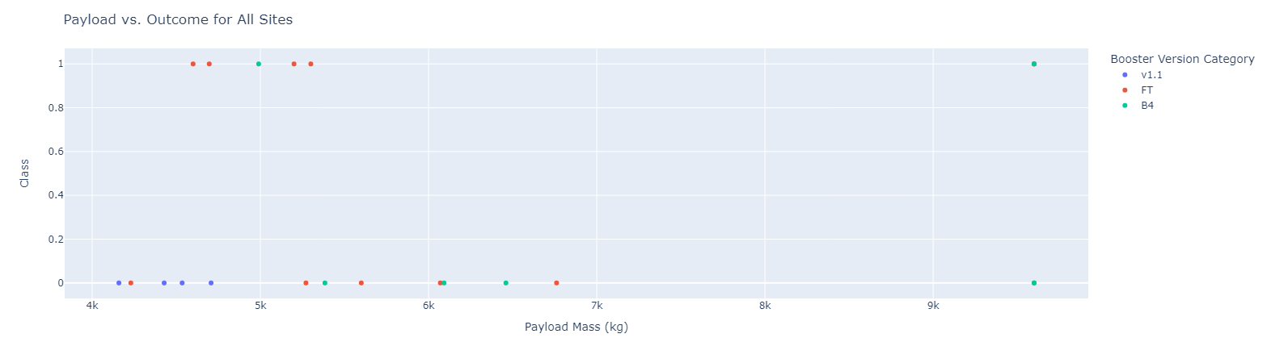
Results
Exploratory data analysis results:
Most of the flights are sent to GTO, ISS orbit as these are orbits where satellite are.
Currently there are 4 Launch sites and 3 of them are located near Melbourne and 1 near Lompoc
VAFB SLC 4E is used only to launch a max payload of 10000 kg
Success rate is Increasing year by year with new Booster versions
Interactive dash:
Predictive analysis results:
Decision tree is the best model suited for the prediction

Slide 19

Section 2

Slide 20
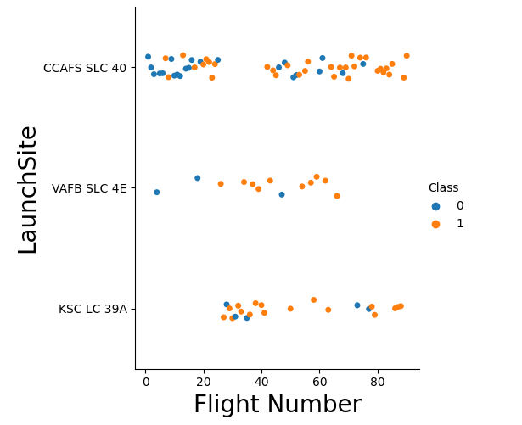
Flight Number vs. Launch Site
We can see that CCAFS SLC 40 has the highest number of flights.
Also if we check with the increase in flight numbers the success rate is more.

Slide 21
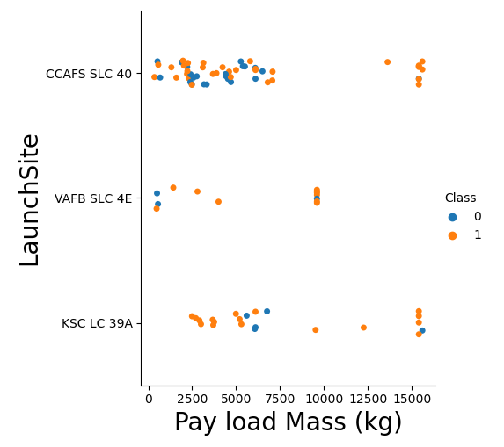
Payload vs. Launch Site
CCAFS SLC 40 & KSC LC 39A can be used for payload mass greater than 10,000 Kg.
Whereas VAFB SLC 4E is limited to 10,000 Kg.

Slide 22
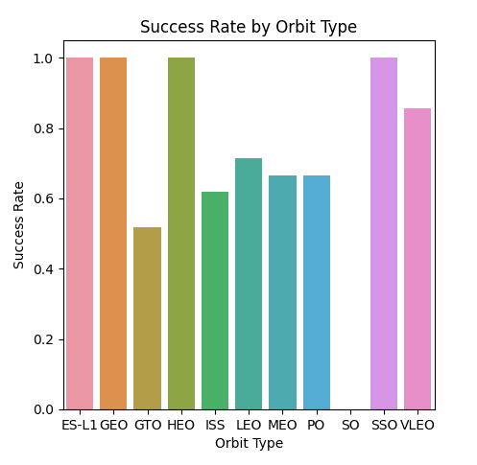
Success Rate vs. Orbit Type
Success rate of ES-L1, GEO, HEO, SSO seems to be high but when accounted with total number of samples considered SSO can be considered as best performing.

Slide 23
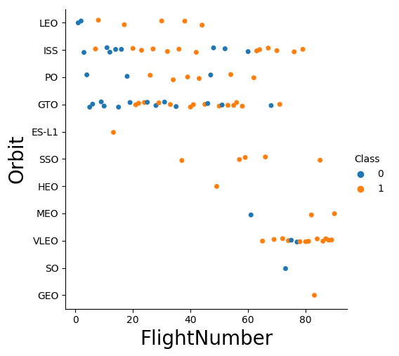
Flight Number vs. Orbit Type
As we can see the highest flights sent are to GTO & ISS orbits.
Least number of flights sent to ES-L1, GEO, SO & HEO, so it will be difficult to predict outcome due to insufficient data.

Slide 24
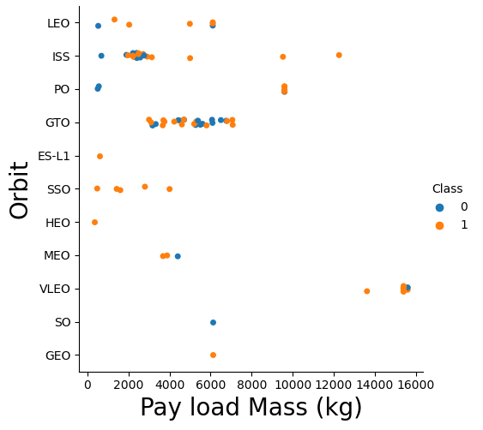
Payload vs. Orbit Type
We can see that VLEO orbit requires highest payload approximately above 13,000 Kg.
PO & ISS orbits come to the next range where payload mass is above 8,000 Kg.

Slide 25
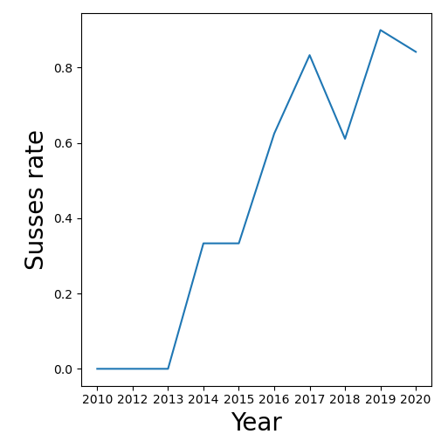
Launch Success Yearly Trend
We can Notice a significant increase in the success rate with Time

Slide 26
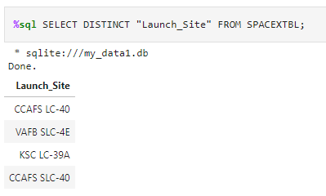
All Launch Site Names
We have selected Distinct Launch Site names to display the launch site names without repetition.

Slide 27
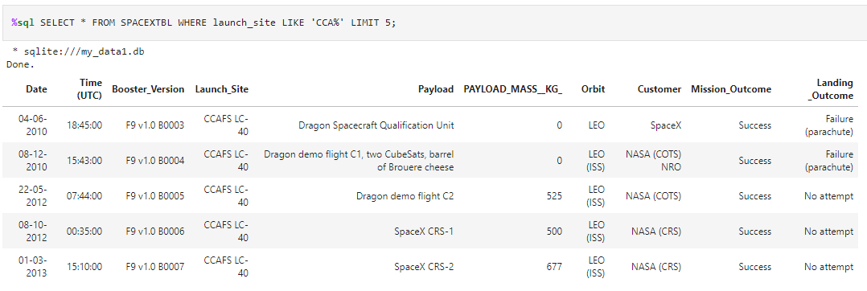
Launch Site Names Begin with 'CCA'
We have applied a Where condition to meet the requirement to begin with `CCA` and a LIMIT to display only 5 rows

Slide 28
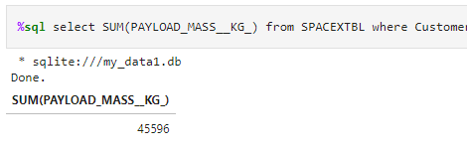
Total Payload Mass
We have calculated the total payload carried by boosters from NASA by applying the SUM() function and a Where condition to meet the requirement of Customer to be NASA.

Slide 29
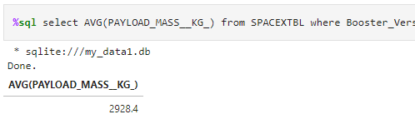
Average Payload Mass by F9 v1.1
We have calculated the average payload mass carried by booster version F9 v1.1 by using the function AVG() and a WHERE condition to meet the requirement of Booster version to be F9 v1.1.

Slide 30
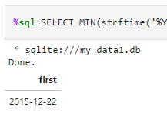
First Successful Ground Landing Date
To find the dates of the first successful landing outcome on ground pad we have used MIN() function and WHERE condition to meet the requirement of Successful ground landing.

Slide 31
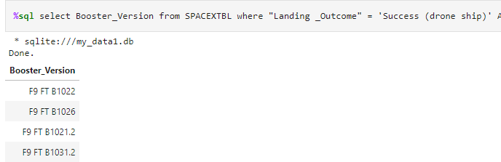
Successful Drone Ship Landing with Payload between 4000 and 6000
We have listed the names of boosters which have successfully landed on drone ship and had payload mass greater than 4000 but less than 6000 by using WHERE condition.

Slide 32
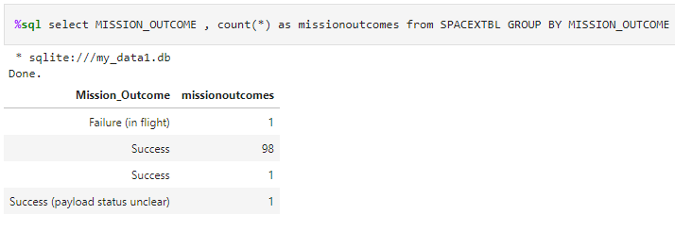
Total Number of Successful and Failure Mission Outcomes
We have calculated the total number of successful and failure mission outcomes by using COUNT() feature.

Slide 33
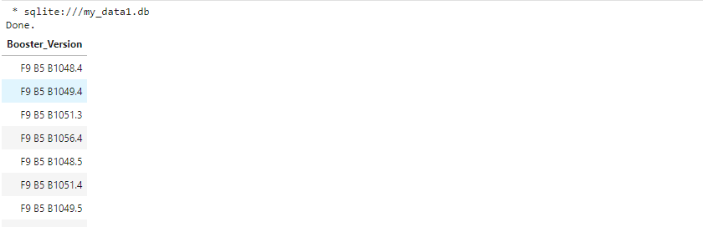
Boosters Carried Maximum Payload
We have listed the names of the booster which have carried the maximum payload mass by using the function MAX().

Slide 34
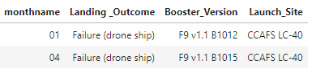
2015 Launch Records
We have listed the failed landing outcomes in drone ship, their booster versions, and launch site names for in year 2015.

Slide 35
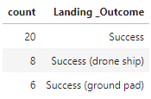

Rank Landing Outcomes Between 2010-06-04 and 2017-03-20
We have ranked the count of landing outcomes (such as Failure (drone ship) or Success (ground pad)) between the date 2010-06-04 and 2017-03-20, in descending order

Slide 36

Section 3

Slide 37
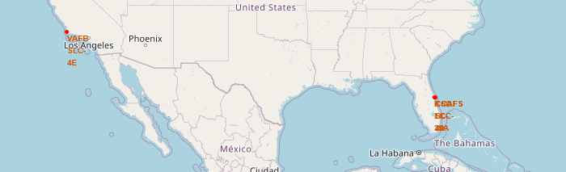
Launch Sites
In the above Global map we can see all the launch sites location Marker
We can see that launch sites are mainly in two areas, 3 of them are located near Melbourne and 1 near Lompoc.
We can also notice that all the launch sites are near the coast line

Slide 38
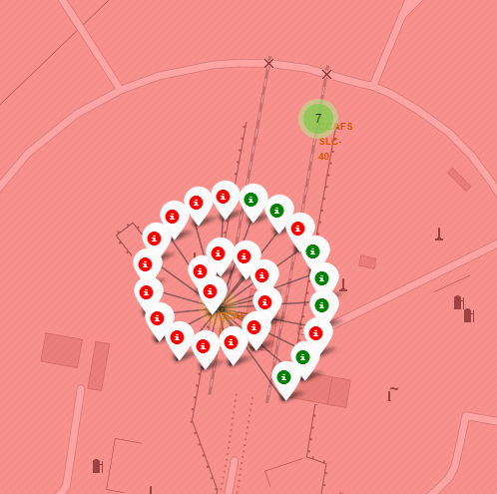
Colour Labeled Launch Outcomes
Successful Outcomes are labeled Green on the map.
Unsuccessful Outcomes are labeled red on the map.

Slide 39
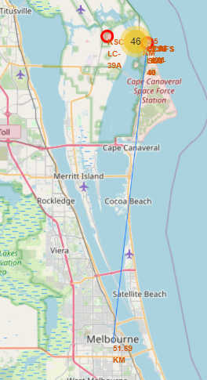
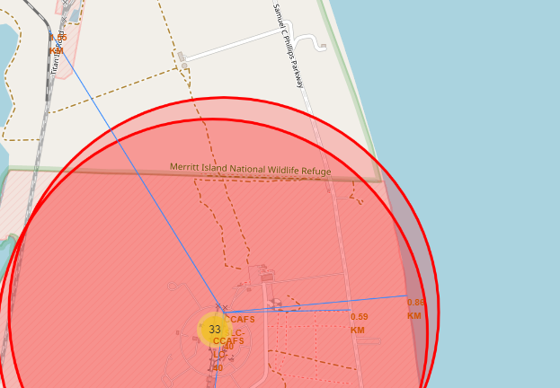
Distance of CCAFS SLC-40
Coastline- 0.85 km
Highway- 0.55 Km
Railway- 1.55 Km
Melbourne City- 51.59 Km
Launch site Distance
Launch site distance from various areas are displayed on the map with a line and the Distance in Kilo-meters

Slide 40

Section 4

Slide 41
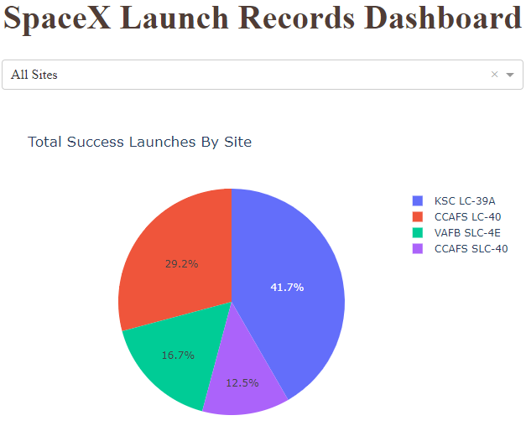
All Sites Success Launches
We see that KSC LC-39A which comprises of 41.7% of all sites, has the highest Successful Launches
And CCAFS SLC-40 which comprises of only 12.5% of all sites, is lowest when compared on the basis of success rate

Slide 42
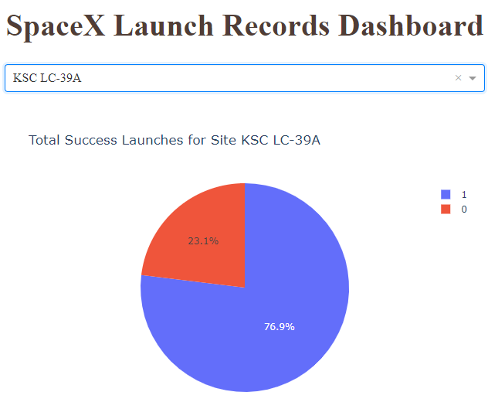
Site With Highest Success
As we know that KSC LC-39A has the highest successful launches when we dig into more data we see that Success rate at this site is 76.9% and the failure rate is 23.1%.
So this implies that 3 out of 4 launches tend to be successful.

Slide 43
Interactive Scatterplot of Payload vs Outcome
When we choose the range between 0 to 10000 Kg, we notice that there are very fewer flight above 7000 Kg payload and those are of B4 Booster version.
Range 0 to 10,000 Kg

Slide 44
Interactive Scatterplot of Payload vs Outcome
In the Range between 0 to 6000 Kg we can see that Booster version FT have better success rate when compared to others and also notice that v1.0 and v1.1 have lowest success rate and have low payload mass.
Range 0 to 6,000 Kg

Slide 45
Interactive Scatterplot of Payload vs Outcome
If we check in the range 4000 to 10000 Kg, we notice that FT & B4 can be seen with success but mostly it is failure . So we can conclude that chances of failure in this payload range is more for v1.1, FT, B4.
Range 4,000 to 10,000 Kg

Slide 46

Section 5

Slide 47
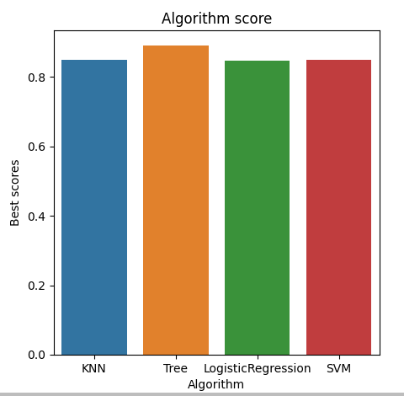
Classification Accuracy
Decision Tree model has the highest classification accuracy of around 0.89

Slide 48
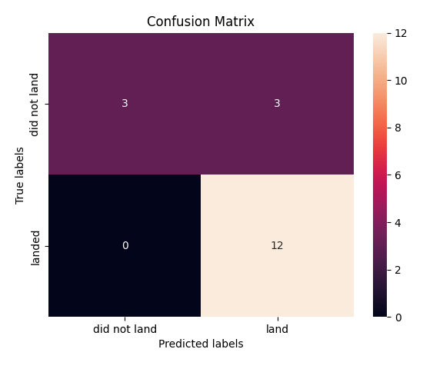
Confusion Matrix
Show the confusion matrix of the best performing model with an explanation

Slide 49
Conclusions
The success rate of sending a flight to SEO orbit is comparatively higher than any other orbit
With time the success rate is increasing.
Launch sites are supposed to be far from human habitat.
Out of all sites KSC LC-39A is preferable due to its high success rate.
Booster version B4 & FT are preferable due to higher success rate.
Decision Tree is the best model preferable to predict Landing Outcomes.

Slide 50

Appendix
For more data related to this project please refer the following GitHub URL: https://github.com/SoorajSheregar/Capstone-Project

Slide 51


